Slide 1

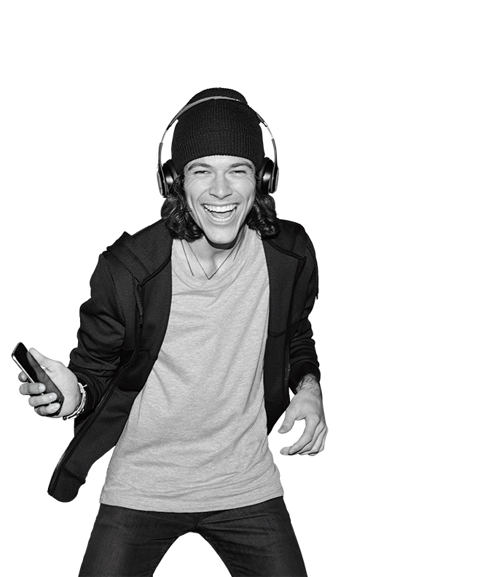

TR# 2017325

Slide 2
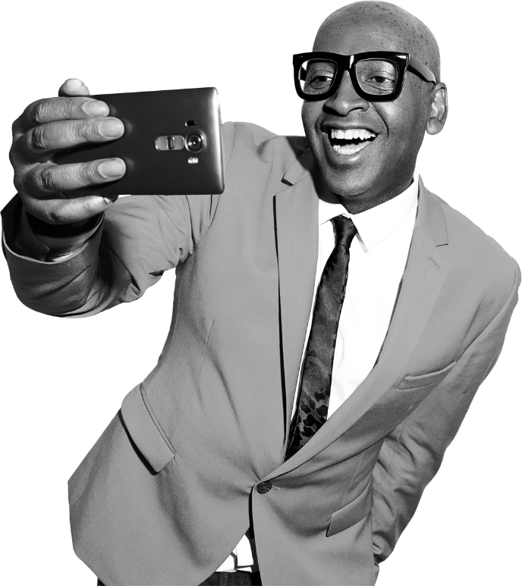


Welcome to
Team Magenta
2 – Welcome to Team Magenta
T-Mobile confidential and proprietary information. Not for customer distribution.

Slide 3

LEADER VIDEO
3 – Welcome to Team Magenta
T-Mobile confidential and proprietary information. Not for customer distribution.

Slide 4
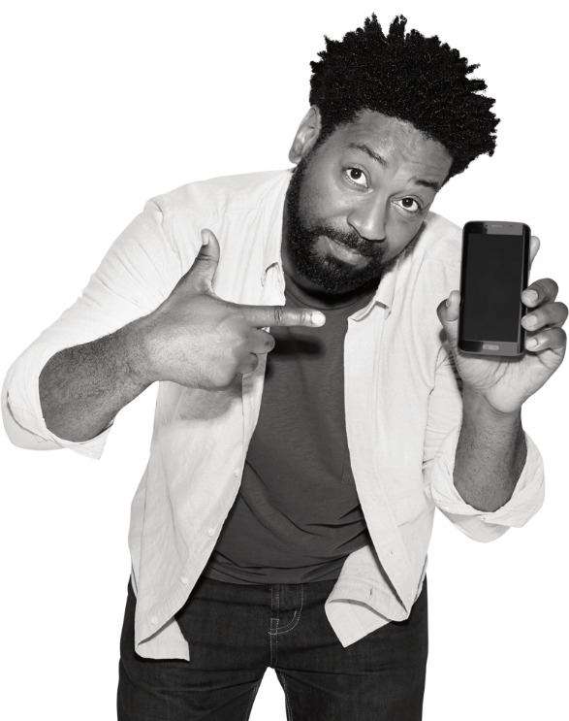
INTRO
Today is all about:
T-Mobile is a great place to work!
What’s in store in the weeks ahead.
We are Serious Fun!
It’s all about who you know!
Mobile Experts in action.
4 – Welcome to Team Magenta
T-Mobile confidential and proprietary information. Not for customer distribution.

Slide 5
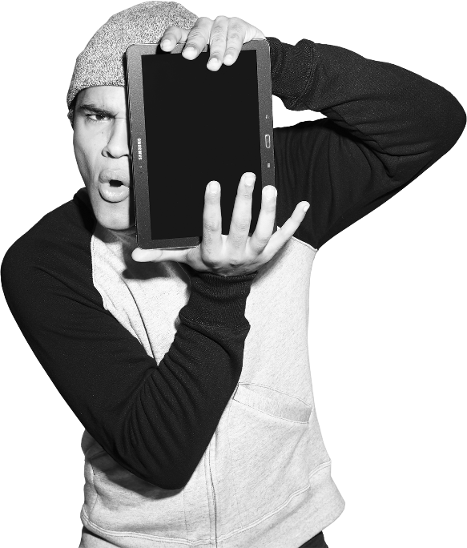
Starting Your Day
What is…
REMO
T-Mobile Connect
5 – Welcome to Team Magenta
T-Mobile confidential and proprietary information. Not for customer distribution.
Notes:
Deliver this slide if you have attended an #UNSTOPPABLE event, and are live with T-Mobile Connect.

Slide 6
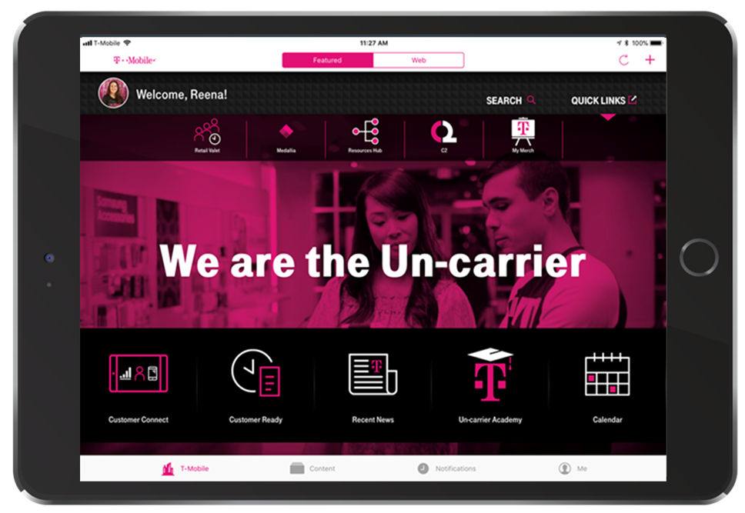
1
2
3
4
6 – Welcome to Team Magenta
T-Mobile confidential and proprietary information. Not for customer distribution.
Notes:
Deliver this slide if you have attended an #UNSTOPPABLE event, and are live with T-Mobile Connect.

Slide 7
T-MOBILE CONNECT RESOURCES
7 – Welcome to Team Magenta
T-Mobile confidential and proprietary information. Not for customer distribution.
Notes:
Deliver this slide if you have attended an #UNSTOPPABLE event, and are live with T-Mobile Connect.

Slide 8
ICEBREAKER ACTIVITY
15 MIN
This activity includes four rounds.
Toss a ball to someone.
Ask their name.
Say, "Hi Freddy, My name is James. Here you go!"
Freddy thanks James, chooses someone else and repeats.
The challenge from here is simply to get the ball tossed around to everyone in the circle, and finally back to the trainer.
8 – Welcome to Team Magenta
T-Mobile confidential and proprietary information. Not for customer distribution.

Slide 9

EXPECTATIONS ACTIVITY
15 MIN
What do we need to do as learners to have a great learning experience?
Create a Learning Agreement.
Put everyone on a level playing field.
9 – Welcome to Team Magenta
T-Mobile confidential and proprietary information. Not for customer distribution.

Slide 10

CAREER PATH
A clear path of success & it starts right now!
Mobile Associate
Mobile Expert
Sr. Mobile Expert
10 – Welcome to Team Magenta
T-Mobile confidential and proprietary information. Not for customer distribution.

Slide 11
MOBILE ASSOCIATE
Ready!
1. Providing the Un-Carrier Experience
2. Product & Services Expertise
3. Systems, Tools, & Resources Proficiency
SEE IT
Self-paced micro-learning that takes place in each day/module. Use eLearning, C2, videos, and sales floor observations to explore topics.
TRY IT
Bring concepts to life. Practice skills with coworkers and facilitators
SHOW IT
Ongoing certification process during the 3 weeks. 3 checkpoint knowledge checks evaluate weeks’ knowledge & 2 skill practice evaluations.
11 – Welcome to Team Magenta
T-Mobile confidential and proprietary information. Not for customer distribution.

Slide 12
MOBILE EXPERT
Mobile Expert Certification
1. Interaction Model LIVE!
2. Personalized Transactions
3. Side-by-Side the Right Way
4. Make the Right Choice
SEE IT
Micro-learning is self-paced. Use eLearning, articles, and videos, and online chat to explore concepts in-depth.
TRY IT
Bring concepts to life, on the job. Practice skills with customers, coworkers, and managers, while gaining sales metrics.
SHOW IT
Feedback is built into the plan. Four checkpoint quizzes evaluate path knowledge, and invite feedback.
12 – Welcome to Team Magenta
T-Mobile confidential and proprietary information. Not for customer distribution.

Slide 13

READY INS AND OUTS
Three week program
Awareness: define & describe
Overview: search & find
Deep Dive: try & apply
Certification
Three Knowledge Checks
Two Skill Practice Evaluations
13 – Welcome to Team Magenta
T-Mobile confidential and proprietary information. Not for customer distribution.

Slide 14
Pay Philosophy
It’s Simple. We’re About The Customer!
How we sell isn’t by shouting features and benefits at our customers.
We sell by giving customers what they want, when they want it, and how they want it.
It’s on their terms!
14 – Welcome to Team Magenta
T-Mobile confidential and proprietary information. Not for customer distribution.

Slide 15

TEAM ACTIVITY #1
1 HR
The Mohawk Activity
Write your name on your Mohawk page so it can be easily identified.
Once everyone has completed their Mohawks:
Each of you will be invited to share your design and what it expresses.
Each Mohawk will be photographed so there will be a digital record.
You will send your finished Mohawk to the Facilitator.
15 – Welcome to Team Magenta
T-Mobile confidential and proprietary information. Not for customer distribution.

Slide 16

The Download
When has a person helping you in a store made the experience so amazing that you planned to ask for them by name the next time you were in the store?
Why is personality so important to making the customer experience great?
16 – Welcome to Team Magenta
T-Mobile confidential and proprietary information. Not for customer distribution.

Slide 17
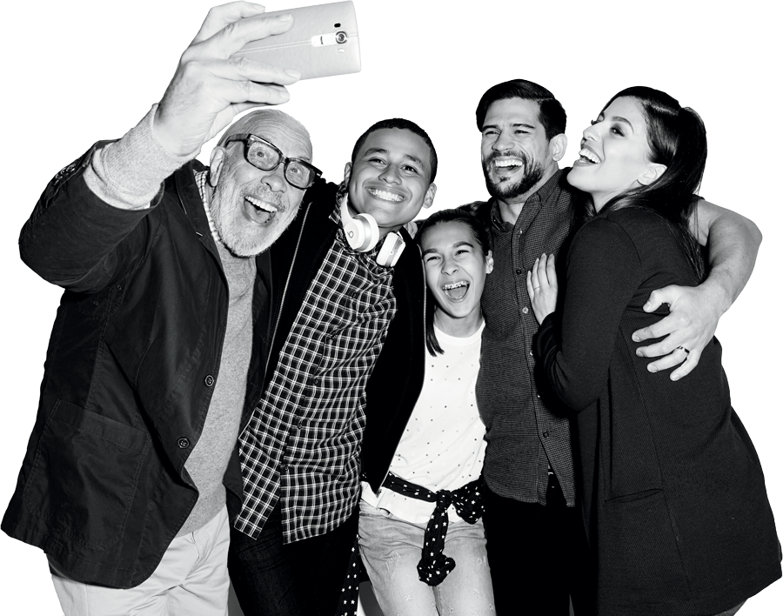
HR PRESENTATION
17 – Welcome to Team Magenta
T-Mobile confidential and proprietary information. Not for customer distribution.

Slide 18
DIVERSITY & INCLUSION
What is Diversity at T-Mobile?
Diversity is a reality!
What is Inclusion at T-Mobile?
Inclusion is a strategy!
18 – Welcome to Team Magenta
T-Mobile confidential and proprietary information. Not for customer distribution.

Slide 19
DIVERSITY & INCLUSION
Why is Diversity & Inclusion Important?
Create an environment
Respect culture and values
Reflect our customers
Sustain a collaborative, innovative atmosphere
19 – Welcome to Team Magenta
T-Mobile confidential and proprietary information. Not for customer distribution.

Slide 20
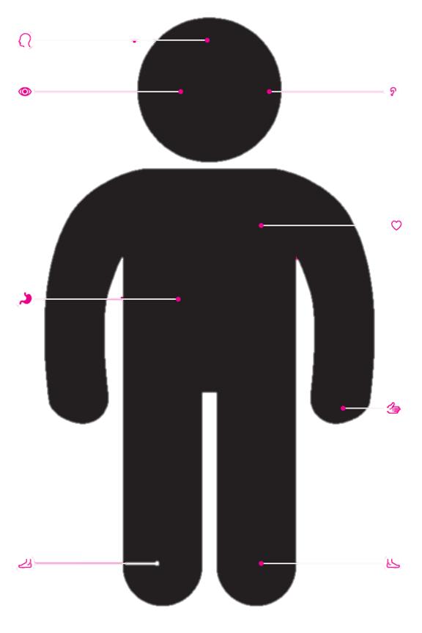
TEAM ACTIVITY #2
15 MINS
Body Part Activity
Head: Dream or goal
Ears: Things we listen to
Eyes: How people see us
Hands: Things we make/do
Stomach: Favorite food
Heart: Strong value or belief
Right foot: Places we visit
Left foot: Place we wish to visit
20 – Welcome to Team Magenta
T-Mobile confidential and proprietary information. Not for customer distribution.

Slide 21

Sales Floor Activities
GROUP A
Look for:
How does the ME provide a WOW customer experience?
Do you see any best practices that you may want to use?
The different types of interactions or customer requests?
Is it all about sales?
GROUP B
Complete: Kronos Timekeeper: Hourly Employee WBT (COR ONLY)
Watch the Social Media at T-Mobile Video (TPR ONLY):
https://c2.t-mobile.com/docs/DOC-437914
21 – Welcome to Team Magenta
T-Mobile confidential and proprietary information. Not for customer distribution.

Slide 22

The Download
Did you see a WOW customer experience?
What types of interactions did you observe?
What best practices did you take away from the observations?
How did MEs position sales?
Why is it important to be conscious of your social media brand when posting about T-Mobile?
22 – Welcome to Team Magenta
T-Mobile confidential and proprietary information. Not for customer distribution.

